Slide 2
Normalization

Slide 3
Normalization
Normalization is the process of organizing the data in the database.
Normalization is used to minimize the redundancy from a relation or set of relations. It is also used to eliminate the undesirable characteristics like Insertion, Update and Deletion Anomalies.
Normalization divides the larger table into the smaller table and links them using relationship.

Slide 4
Normalization
Redundancy
Process of organizing the data
To Avoid
Anomaly

Slide 5
Purpose of Normalization
Eliminating redundant (useless) data
Ensuring data dependencies make sense i.e data is logically stored

Slide 6
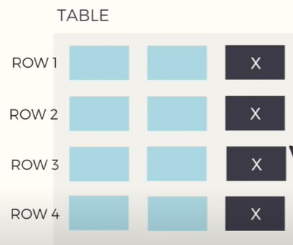
Redundancy
Data redundancy occurs when the same piece of data is stored in two or more separate places
having multiple copies of same data in the database increases the size of the database

Slide 7
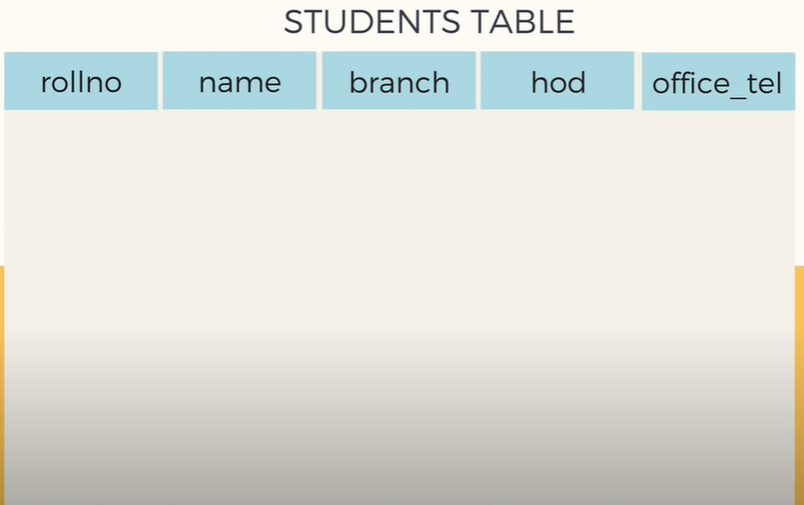
Redundancy

Slide 8
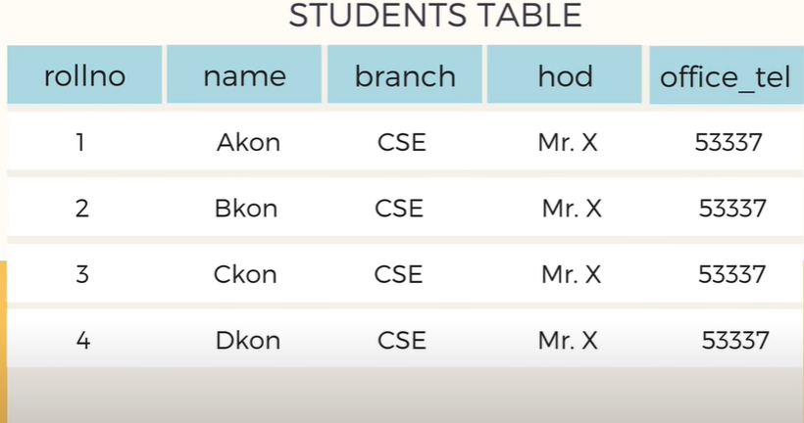
Redundancy
Unnecessary Repetitions

Slide 9
Anamoly
Caused due to
too much redundancy
Poor Construction of Tables

Slide 10
Anamoly - Types
Insertion Anomaly
Updation Anomaly
Deletion Anomaly

Slide 11
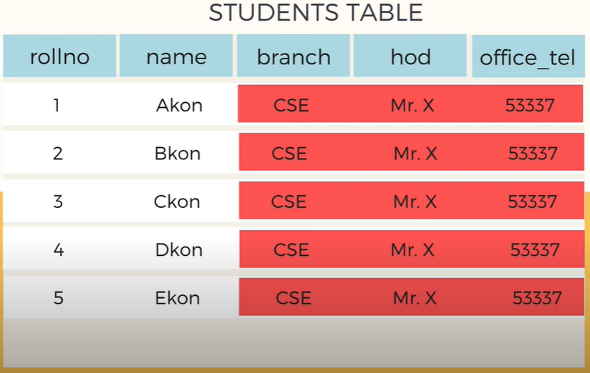
Insertion Anamoly
Inserting a row in this table makes to insert redundant data for every row

Slide 12
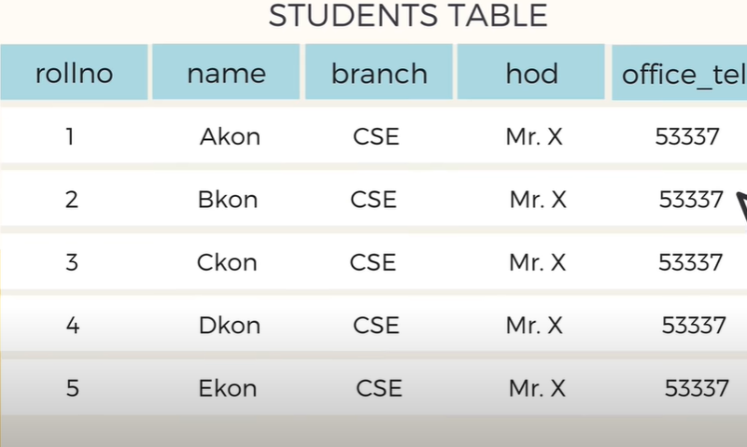
Updation Anamoly
Suppose Hod Mr.Y Joins
Updation of HoD information has to be done in all rows

Slide 13
Deletion Anamoly
Details of students who left the college has to be deleted

Slide 14
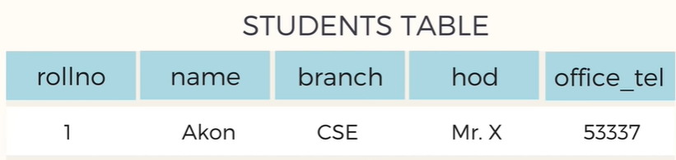
Deletion Anamoly
If we delete this row , branch details also gets deleted

Slide 15
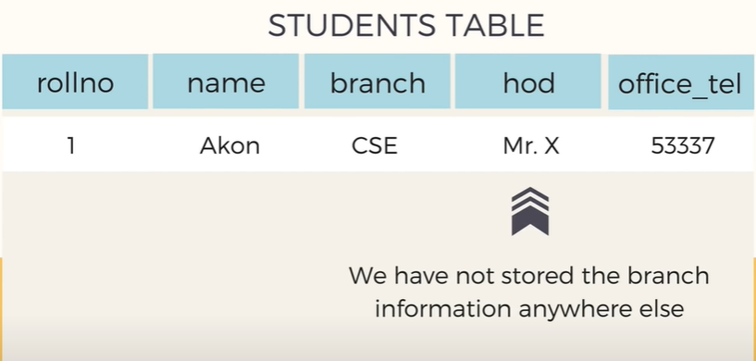
Deletion Anamoly

Slide 16
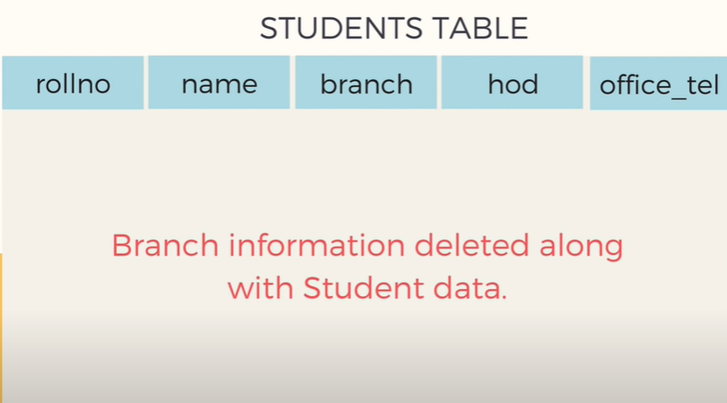
Deletion Anamoly
Loss of a related data when some other data is deleted

Slide 17
How Normalization Solves this issues?

Slide 18
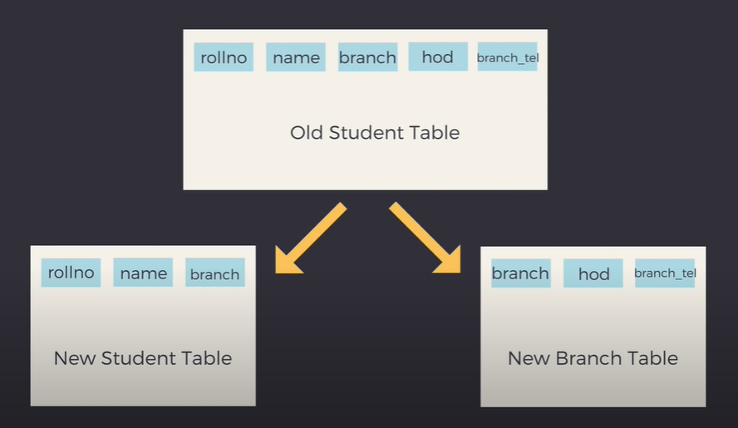

Slide 19
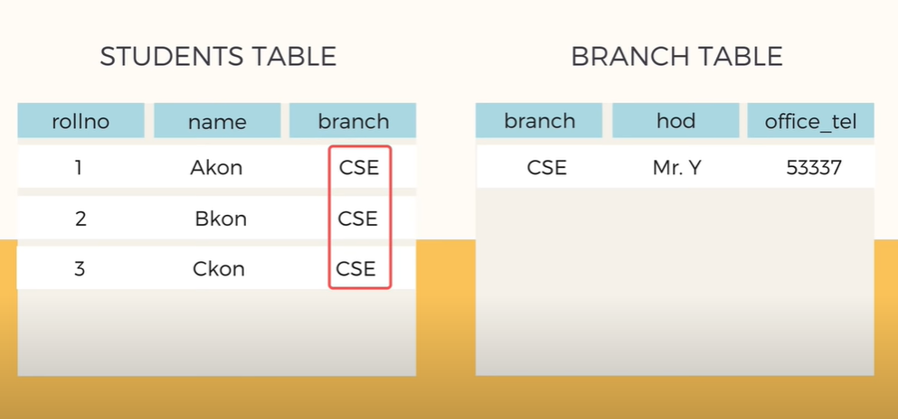

Slide 20
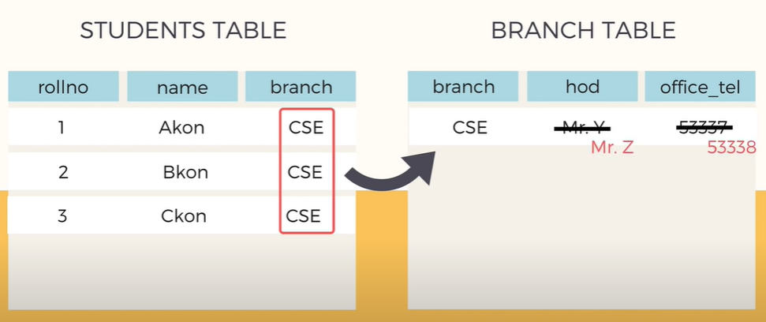
Avoiding Updation anomaly

Slide 21
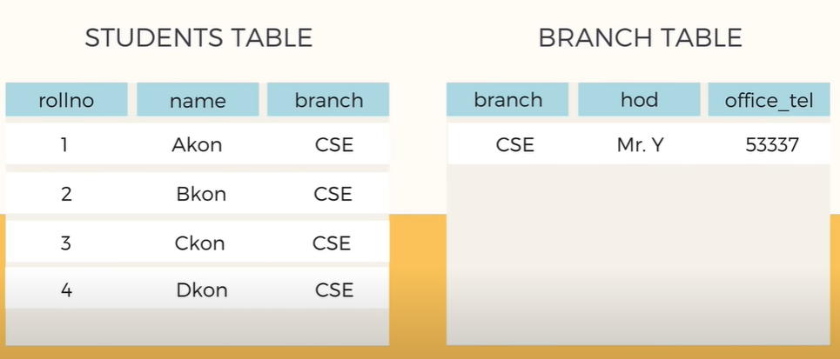
Insertion anomaly Solved

Slide 22
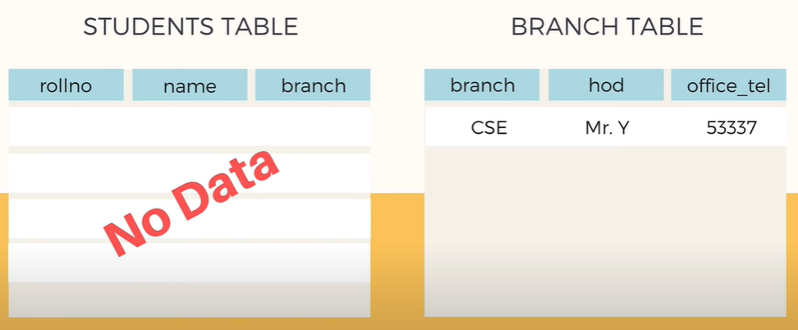
Deletion anomaly Solved

Slide 23
Functional Dependencies
The functional dependency is a relationship that exists between two attributes. It typically exists between the primary key and non-key attribute within a table.
Eg: X→ Y
The left side of FD is known as a determinant, the right side of the production is known as a dependent.

Slide 24
Functional Dependencies
Assume we have an employee table with attributes: Emp_Id, Emp_Name, Emp_Address.
Here Emp_Id attribute can uniquely identify the Emp_Name attribute of employee table because if we know the Emp_Id, we can tell that employee name associated with it.
Functional dependency can be written as:
Emp_Id → Emp_Name

Slide 25
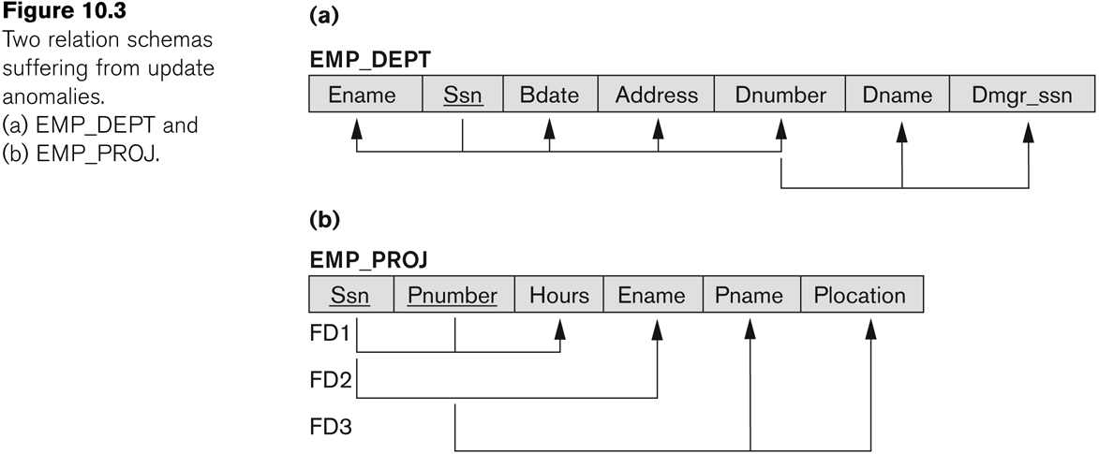
Graphical representation of Functional Dependencies

Slide 26
Examples of FD constraints
Social security number determines employee name
SSN -> ENAME
Project number determines project name and location
PNUMBER -> {PNAME, PLOCATION}
Employee SSN and project number determines the hours per week that the employee works on the project
{SSN, PNUMBER} -> HOURS

Slide 27
Examples of FD constraints
An FD is a property of the attributes in the schema R
The constraint must hold on every relation instance r(R)
If K is a key of R, then K functionally determines all attributes in R
(since we never have two distinct tuples with t1[K]=t2[K])
In Employee table if : SSN → Ename, if we have 5 rows in Employee table
SSN→ Ename should hold true for all the rows.

Slide 28
Inference Rules for FDs
The Armstrong's axioms are the basic inference rule.
Armstrong's axioms are used to conclude functional dependencies on a relational database.
The inference rule is a type of assertion. It can apply to a set of FD(functional dependency) to derive other FD.
Using the inference rule, we can derive additional functional dependency from the initial set.

Slide 29
Inference Rules for FDs
The Functional dependency has 6 types of inference rule:
Reflexive Rule.
Augmentation Rule.
Transitive Rule.
Union Rule.
Decomposition Rule.
Pseudo Transitive Rule.

Slide 30
Inference Rules for FDs
Reflexive Rule: In the reflexive rule, if Y is a subset of X, then X determines Y.
If X ⊇ Y then X → Y
Example:
X = {a, b, c, d, e}
Y = {a, b, c}

Slide 31
Inference Rules for FDs
Augmentation Rule : The augmentation is also called as a partial dependency. In augmentation, if X determines Y, then XZ determines YZ for any Z.
If X → Y then XZ → YZ
Example:
For R(ABCD), if A → B then AC → BC

Slide 32
Inference Rules for FDs
Transitive Rule : In the transitive rule, if X determines Y and Y determine Z, then X must also determine Z.
If X → Y and Y → Z then X → Z
Union Rule : Union rule says, if X determines Y and X determines Z, then X must also determine Y and Z.
If X → Y and X → Z then X → YZ

Slide 33
Inference Rules for FDs
Decomposition Rule : Decomposition rule is also known as project rule. It is the reverse of union rule.
This Rule says, if X determines Y and Z, then X determines Y and X determines Z separately.
If X → YZ, then X → Y and X → Z
Pseudo transitive Rule : In Pseudo transitive Rule, if X determines Y and YZ determines W, then XZ determines W.
If X → Y and YZ → W then XZ → W

Slide 34
Definitions of Keys and Attributes
A key in DBMS is an attribute or a set of attributes that help to uniquely identify a tuple (or row) in a relation (or table). Keys are also used to establish relationships between the different tables and columns of a relational database.
Types of keys in DBMS:
Primary Key
Candidate Key
Super Key
Foreign Key
Composite Key

Slide 35
Definitions of Keys and Attributes
If a relation schema has more than one key, each is called a candidate key. One of the candidate keys is arbitrarily designated to be the primary key, and the others are called secondary keys.
A Prime attribute must be a member of some candidate key
A Nonprime attribute is not a prime attribute—that is, it is not a member of any candidate key.

Slide 36
Finding the Key Attribute
Consider relation R(A,B,C) having the following F= { A→B, B→C }. Find the key attribute for the given relation R.
Solution
Left Middle Right
A B C
A⁺ = ABC
B⁺ = BC
A closure includes all the attributes of R. So A is the key attribute.
Prime attribute is A
Non Prime attributes are BC

Slide 37
Finding the Key Attribute
Consider relation R(A,B,C,D) having the following F= { AB→C, C→B, C→D }. Find the key attribute for the given relation R.
Solution
Left Middle Right
A BC D
A⁺ = A
AB⁺ = ABCD
AC⁺ = ACBD
AB⁺, AC⁺ includes all the attributes of R. So AB, AC are the key attributes.
Prime attributes are ABC
Non Prime attribute is D

Slide 38
Finding the Key Attribute
Consider relation R(A,B,C) having the following F= { A→B, B→C, C→A }. Find the key attribute for the given relation R.
Solution
Left Middle Right
- ABC -
A⁺ = ABC
B⁺ = ABC
C⁺ = ABC
A⁺, B⁺, C⁺ includes all the attributes of R. So A,B,C are the key attributes.
Prime attributes are ABC
No Non Prime attribute

Slide 39
Finding the Key Attribute
Consider the Relation X(A, B, C, D, E, F, G) with the following dependencies and find the key attribute
i. A → D
ii. A,B → C, D, E, F, G
iii. E → F
iv. B,E → G
v. B,C,G → A,D,E,F
vi. B,C,E → A,D,F,G
Solution : AB

Slide 40
Normalization of Relations
Normalization:
The process of decomposing unsatisfactory "bad" relations by breaking up their attributes into smaller relations
Normal form:
Condition using keys and FDs of a relation to certify whether a relation schema is in a particular normal form

Slide 41
Normalization Types
1NF
2NF
3NF
BCNF
4NF

Slide 42
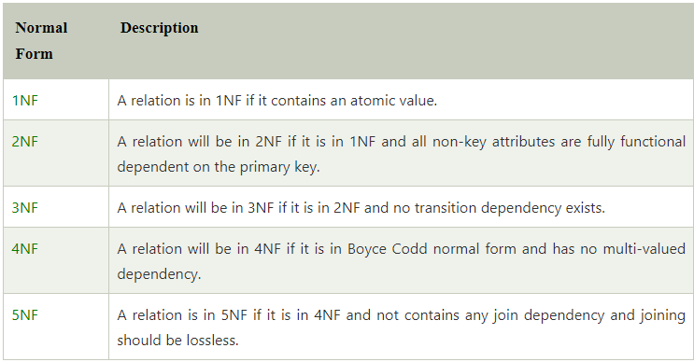
Normalization Types

Slide 43
Normalization of Relations
2NF, 3NF, BCNF
based on keys and FDs of a relation schema
4NF
based on keys, multi-valued dependencies : MVDs
5NF
based on keys, join dependencies : JDs
Additional properties may be needed to ensure a good relational design (lossless join, dependency preservation)

Slide 44
First Normal Form : 1NF
Every Table should be 1NF
Disallows
Multivalued attributes
Nested relations, attributes whose values for an individual tuple are non-atomic
Considered to be part of the definition of relation

Slide 45
First Normal Form : 1NF
It should only have single(atomic) valued attributes/columns.
Values stored in a column should be of the same domain
All the columns in a table should have unique names.
order in which data is stored, does not matter.
4 Rules

Slide 46
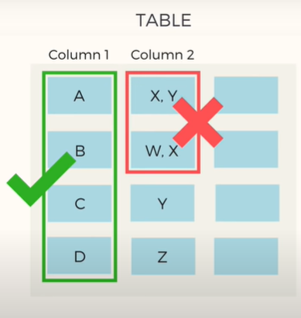
First Normal Form : 1NF (Rule 1)
Each Column should have atomic values
Entries like X,Y and W,X violate this rule

Slide 47
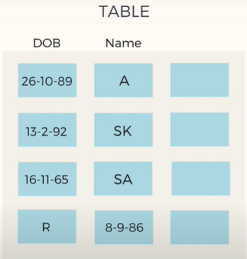

First Normal Form : 1NF (Rule 2)
Column should contain values that are of the same type
Do not inter – mix different types of values in any column

Slide 48
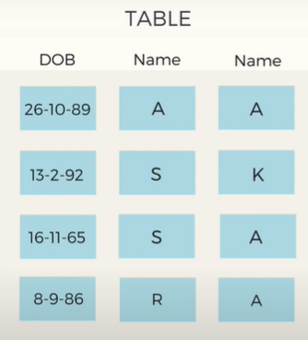

First Normal Form : 1NF (Rule 3)
Each column should have a unique name
Same name leads to confusion at the time of data retrieval

Slide 49
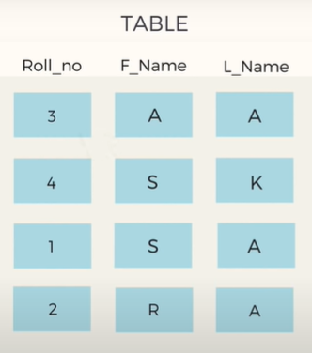
First Normal Form : 1NF (Rule 4)
Order in which data is stored doesn’t matter
Using SQL query, data can be retrieved from table in any order

Slide 50
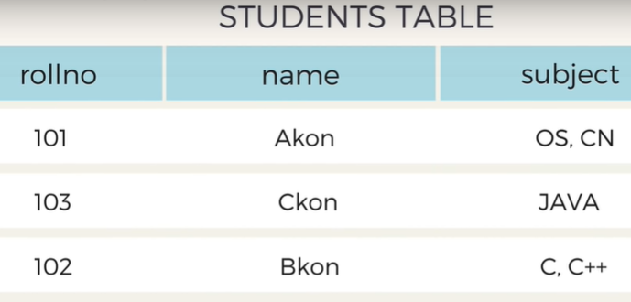

How to solve this?

Slide 51
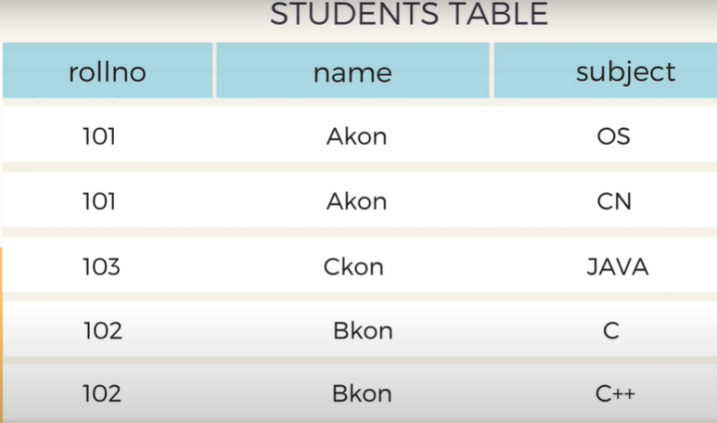
Example:
Split the values to individual rows
1NF

Slide 52

Second Normal Form
2NF

Slide 53
Second Normal Form : 2NF
2 Rules
The table should be in the First Normal Form.
There should be no Partial Dependency.

Slide 54

2NF – Rule 2 – Partial Dependency
Dependency ?

Slide 55
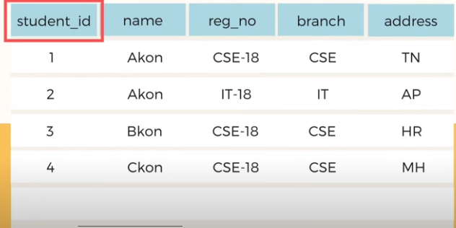
2NF – Rule 2 – Partial Dependency
Student_id is the primary key and their values are unique, so we could fetch any row from this table. Even for the case where student names are same.

Slide 56
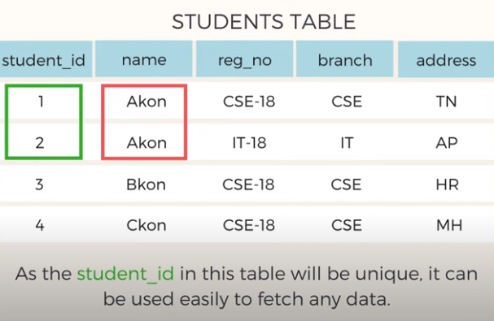
2NF – Rule 2 – Partial Dependency

Slide 57
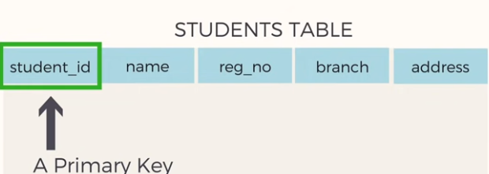
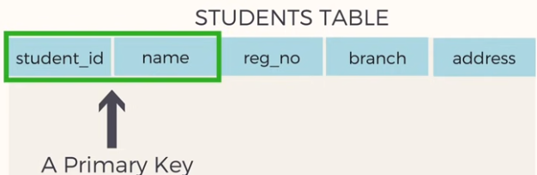
2NF – Rule 2 – Partial Dependency
Primary Key is a column or sometimes a group of column which can uniquely identify each row in the table.
PK can be used to fetch data from any columns in the table.

Slide 58
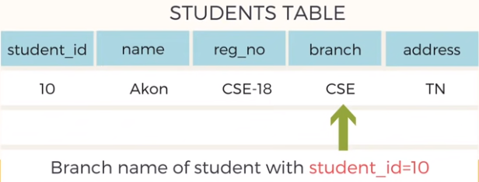
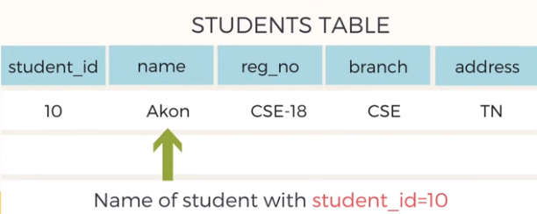
2NF – Rule 2 – Partial Dependency
So all we need is student_id and every other columns depends on it.
This is known as dependency / functional dependency.

Slide 59
2NF – Rule 2 – Partial Dependency
Its time for Partial Dependency

Slide 60
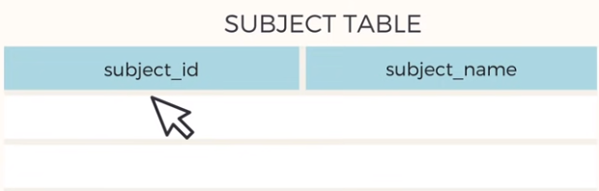
2NF – Rule 2 – Partial Dependency
We already have students table where student_id is the primary key.
We have created another table subject where subject_id is the primary key.

Slide 61
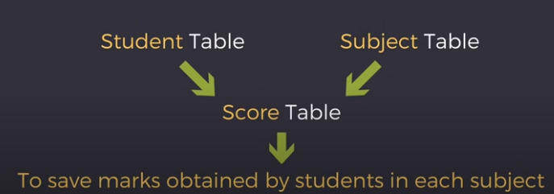
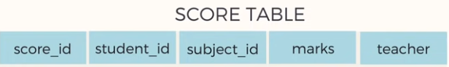
2NF – Rule 2 – Partial Dependency
Now we have student and subject table.
During exams new table called score table is created to save marks obtained by students in each subject. Also name of the teacher who teaches the subject is saved along with the marks.

Slide 62
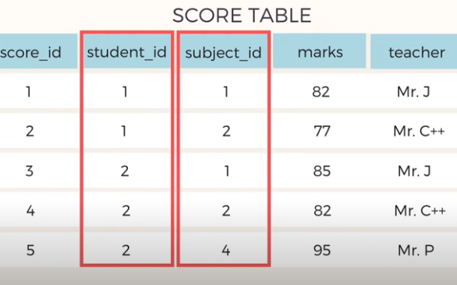
2NF – Rule 2 – Partial Dependency
In the score table we are saving student_id to know which students marks are these.
We also have subject_id to know which subject marks are these.

Slide 63
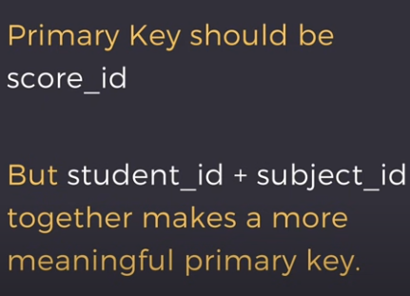
2NF – Rule 2 – Partial Dependency

Slide 64
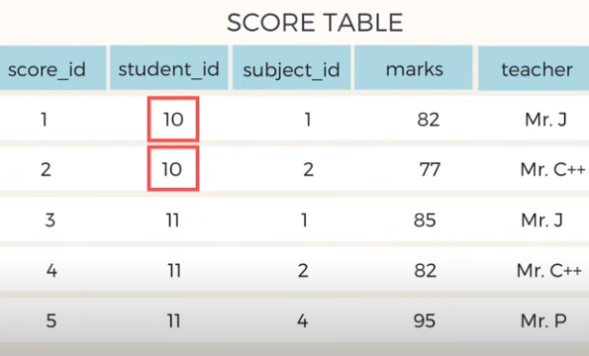
2NF – Rule 2 – Partial Dependency
If we want to retrieve the marks of student with student_id “10” can we get it from the table?
We cannot because we don’t know for which subject.

Slide 65
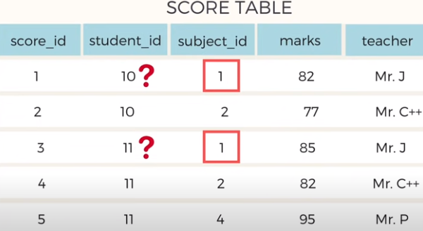
2NF – Rule 2 – Partial Dependency
If we want to retrieve the marks of student with student_id “10” can we get it from the table?
We cannot because we don’t know for which subject.
If subject_id is given we don’t know for which student.

Slide 66

2NF – Rule 2 – Partial Dependency
So we need, Student_id+ subject_id , to uniquely identify any row of data in the score table.
M2M relationship means, a student can opt for more than one subject & one subject can be opted by more than one student.

Slide 67
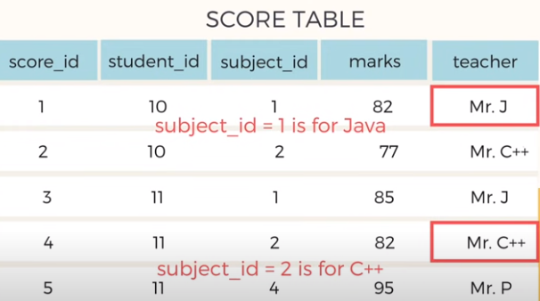
2NF – Rule 2 – Partial Dependency
In this score table we have a column name “Teacher” which is only dependent on the subject.
For Java it is java teacher for C++ it is C++ teacher and so on.

Slide 68
2NF – Rule 2 – Partial Dependency
In the score table primary is the composition of two columns which is “student_id + subject_id” .
But the teachers name is only dependent on the subject. It has nothing to do with student. This is partial dependency.

Slide 69
2NF – Rule 2 – Partial Dependency
But for a table to be in 2NF it should not have any partial dependency.
There are many different ways to remove partial dependency.
But our objective is to remove teacher from the score table.

Slide 70
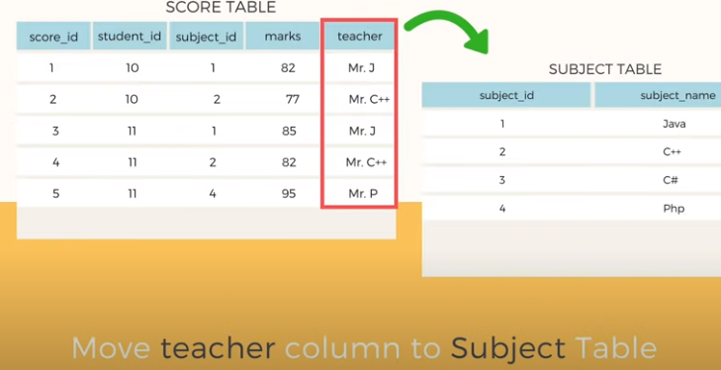
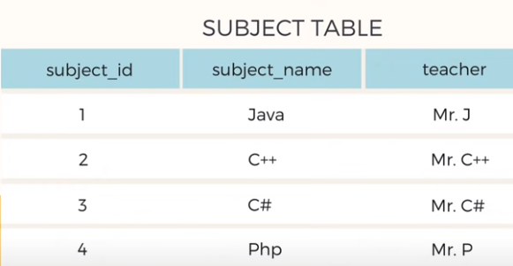
2NF – Rule 2 – Partial Dependency

Slide 71
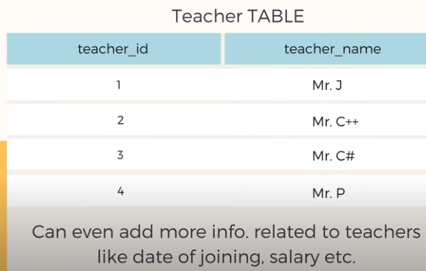
2NF – Rule 2 – Partial Dependency
Another way is to create a separate table for teachers and use “teacher_id” wherever we want.

Slide 72
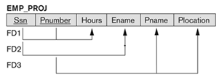
Second Normal Form : 2NF
Examples:
{SSN, PNUMBER} -> HOURS is a full FD since neither SSN -> HOURS nor PNUMBER -> HOURS hold
{SSN, PNUMBER} -> ENAME is not a full FD (it is called a partial dependency ) since SSN -> ENAME also holds

Slide 73
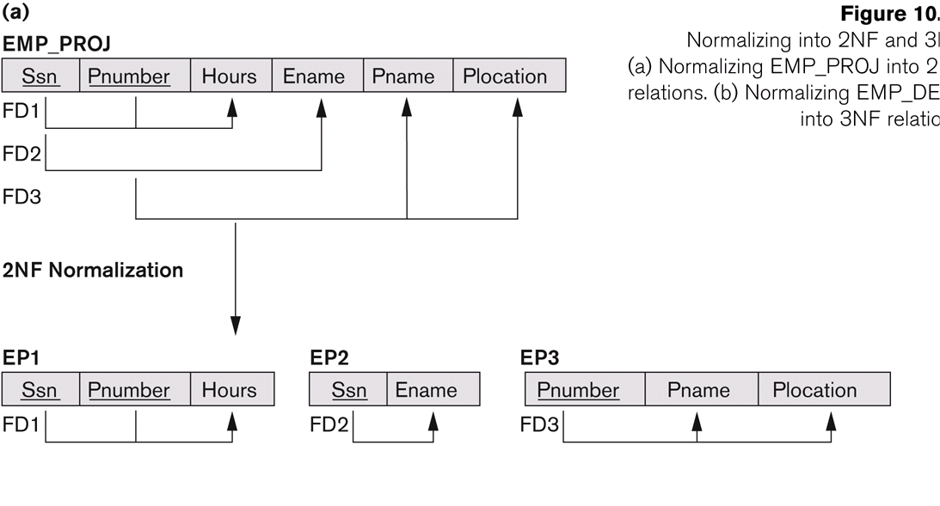
Normalizing into 2NF

Slide 74

Third Normal Form
3NF

Slide 75
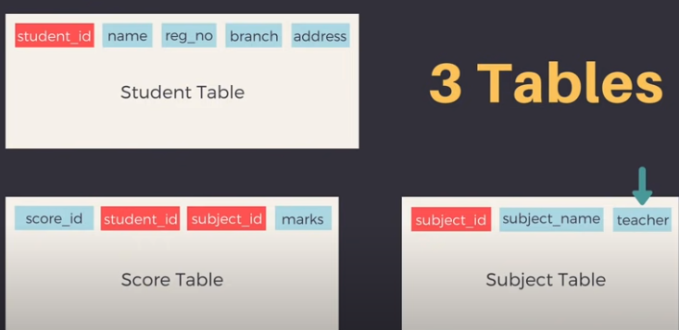
Third Normal Form : 3NF
If we want to save more information in score table like “Exam name and total marks” in the score table.
Should we just add them in the score table?

Slide 76
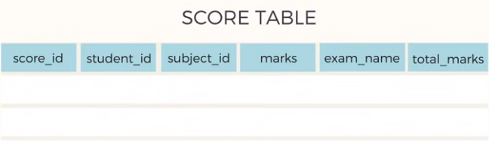
Third Normal Form : 3NF
This is the updated score table with new columns “Exam name and total marks”

Slide 77
Third Normal Form : 3NF
It should be in the Second Normal form.
It should not have Transitive Dependency.
2 Rules

Slide 78
Third Normal Form : 3NF
Its time for Transitive Dependency

Slide 79
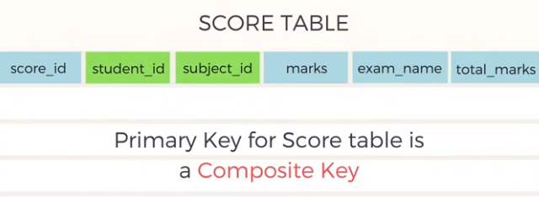
Third Normal Form : 3NF
Column exam_name depends on “student_id + subject_id” .
For eg: MECH student will have “workshop exam” but IT student wont.
IT student will have “practical exam” but MECH student wont.
So exam name depends on student as well as subject.

Slide 80


Third Normal Form : 3NF
So the value of total marks changes based on exam. Hence “total marks depends on exam name”.

Slide 81
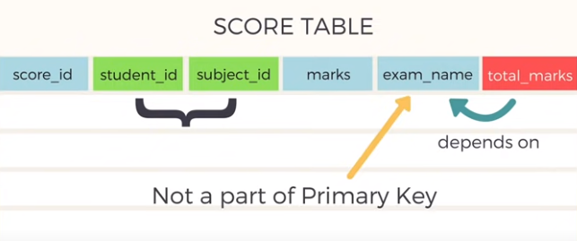
Third Normal Form : 3NF
In the score table the primary key is student_id+subject_id. All the columns in the score table depends on the primary key except the total_marks column which depends on the exam_name which is not a PK.
This is “Transitive dependency”

Slide 82
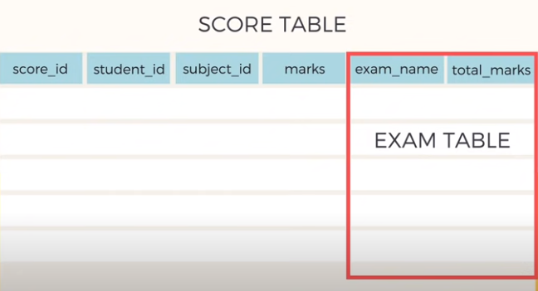
Third Normal Form : 3NF
When there is a attribute in a that table depends on some non- prime attribute and not on the prime attribute is known as “Transitive dependency”
Solution is: Create a new table with exam name and total marks and put them in the exam table and use them with exam_id wherever required.

Slide 83
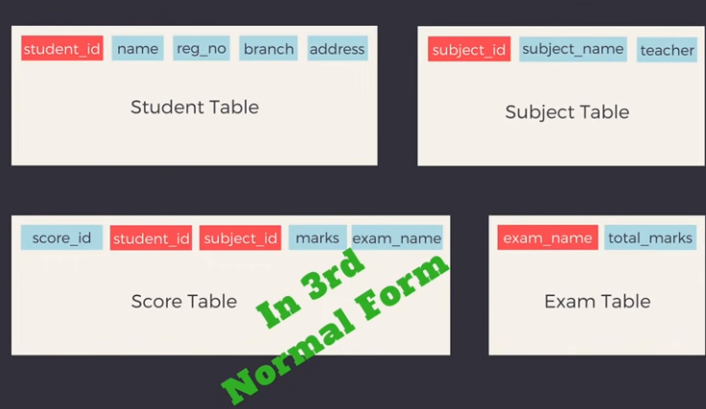
Third Normal Form : 3NF

Slide 84
Third Normal Form : 3NF
Definition:
Transitive functional dependency: a FD X -> Z that can be derived from two FDs X -> Y and
Y -> Z
Examples:
SSN -> DMGRSSN is a transitive FD
Since SSN -> DNUMBER and DNUMBER -> DMGRSSN hold
SSN -> ENAME is non-transitive
Since there is no set of attributes X where SSN -> X and X -> ENAME

Slide 85
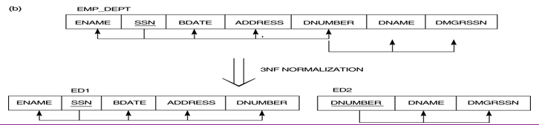
Normalizing into 3NF

Slide 86
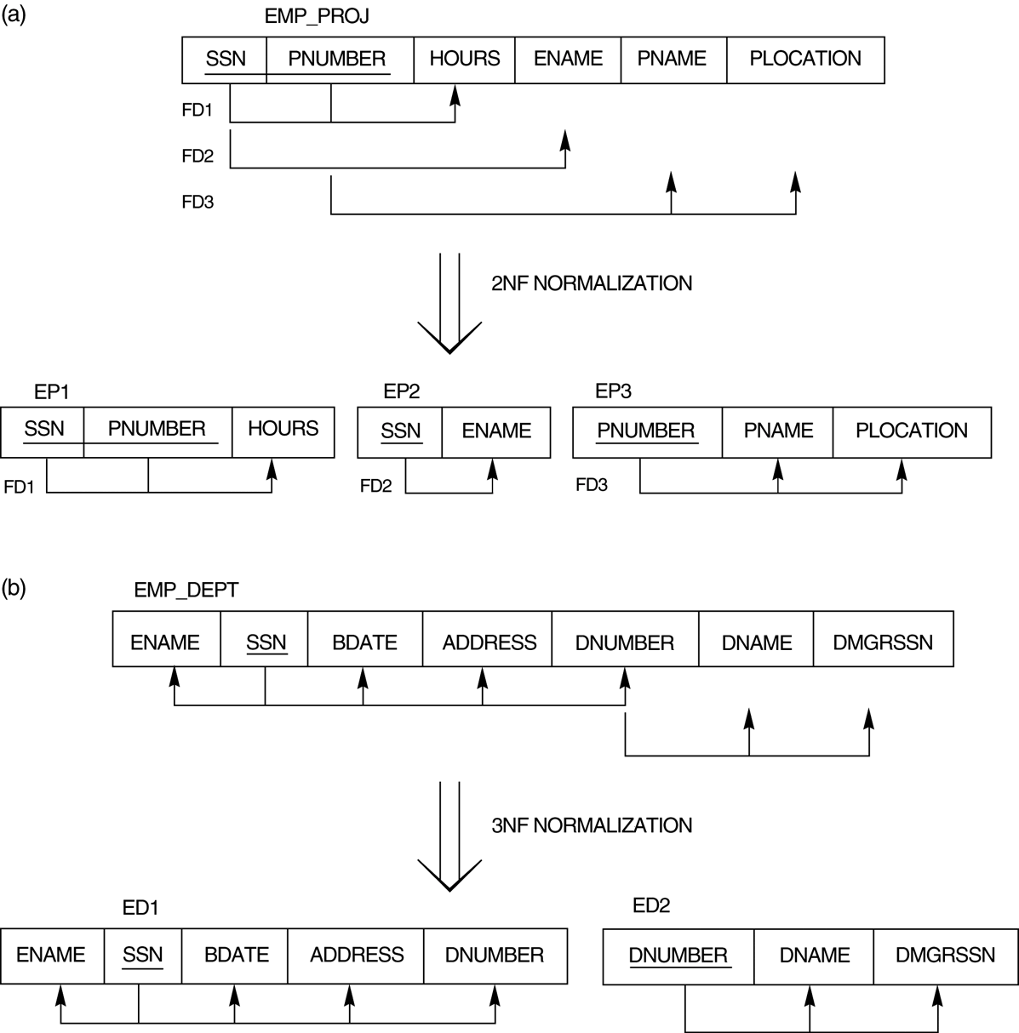
Normalizing into 2NF and 3NF

Slide 87
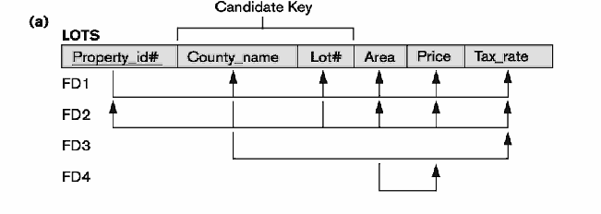
Normalize the following relation

Slide 88
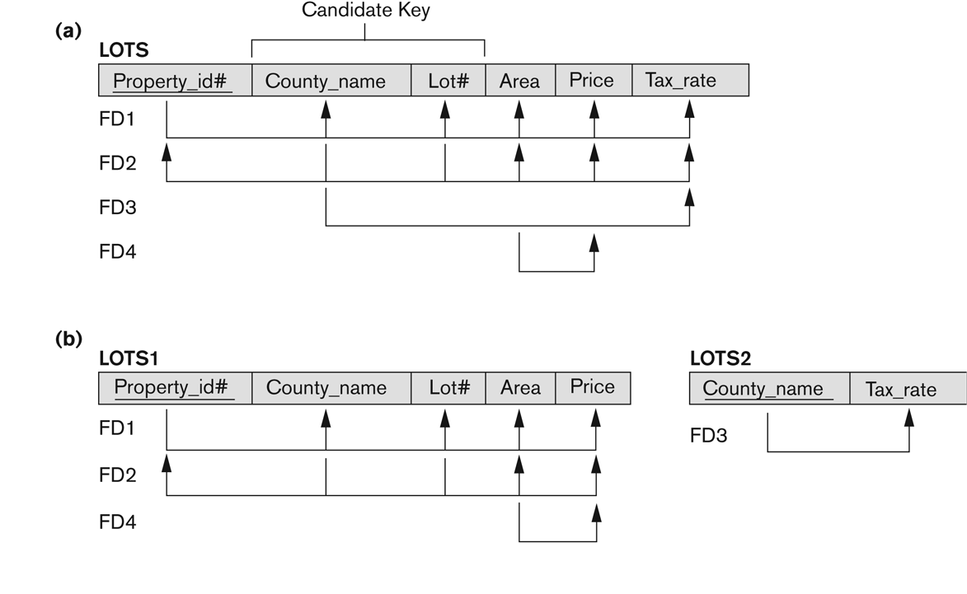
Normalizing into 2NF

Slide 89

Normalizing into 3NF

Slide 90
Boyce-Codd Normal Form
BCNF

Slide 91
BCNF (Boyce-Codd Normal Form)
2 Rules
It should be in the Third Normal Form.
for any dependency A → B, A should be a super key.

Slide 92
BCNF (Boyce-Codd Normal Form)
A relation schema R is in Boyce-Codd Normal Form (BCNF) if whenever an FD X -> A holds in R, then X is a superkey of R
Each normal form is strictly stronger than the previous one
Every 2NF relation is in 1NF
Every 3NF relation is in 2NF
Every BCNF relation is in 3NF
There exist relations that are in 3NF but not in BCNF.
The goal is to have each relation in BCNF (or 3NF)

Slide 93




RECAP…
X
BCNF dosent allow

Slide 94

BCNF (Boyce-Codd Normal Form)
One student can enroll for multiple subjects.
For each subject a professor is assigned to the student.
Note: There can be multiple professors teaching one subject like java

Slide 95

BCNF (Boyce-Codd Normal Form)
In this table “student_id and subject” jointly act as a primary key to uniquely identify rows in this table.

Slide 96

BCNF (Boyce-Codd Normal Form)
All the values are atomic
Column names are unique.
Data saved in each column remains in same domain.

Slide 97


BCNF (Boyce-Codd Normal Form)

Slide 98



BCNF (Boyce-Codd Normal Form)

Slide 99


BCNF (Boyce-Codd Normal Form)

Slide 100


BCNF (Boyce-Codd Normal Form)

Slide 101
DATABASE MANAGEMENT SYSTEMS
UNIT II : DATABASE DESIGN 11
Entity-Relationship Model – ER Diagrams – Functional Dependencies – Non-Loss Decomposition Functional Dependencies – First Normal Form – Second Normal Form – Third Normal Form – Dependency Preservation – Boyce/Codd Normal Form – Multi-Valued Dependencies and Fourth Normal Form – Join Dependencies and Fifth Normal Form.

Slide 102
Fourth Normal Form
4NF

Slide 103
Fourth Normal Form : 4NF
2 Rules
It should be in the Boyce-Codd Normal Form.
The table should not have any Multi-valued Dependency

Slide 104

Fourth Normal Form : 4NF
What is Multi-Valued Dependency
I’m 4NF

Slide 105


Fourth Normal Form : 4NF
For single value of A more than one value of B exist in a table.
Also for a table to have multi – valued dependency it should have atleast three columns.

Slide 106

Fourth Normal Form : 4NF
If we have only two columns we can simple distribute the multi-valued data in multiple rows and there is no need for decomposing the table.

Slide 107


Fourth Normal Form : 4NF

Slide 108

Fourth Normal Form : 4NF
Also in a table multi-valued dependency can exist for more than one columns.

Slide 109
Fourth Normal Form : 4NF
Also in a table multi-valued dependency can exist for more than one columns.

Slide 110

Fourth Normal Form : 4NF
One student has opted for two subjects and has two hobbies.

Slide 111

Fourth Normal Form : 4NF
Student with s_id=1 has hobby cricket and hockey and has opted for two subjects science and maths.

Slide 112

Fourth Normal Form : 4NF
No Relationship

Slide 113

Fourth Normal Form : 4NF

Slide 114


Fourth Normal Form : 4NF

Slide 115



Fourth Normal Form : 4NF

Slide 116

Fourth Normal Form : 4NF
Adding address column, will give both Functional and Multi-Valued Dependency

Slide 117

Fourth Normal Form : 4NF
Its in 4NF

Slide 118
Fifth Normal Form
5NF

Slide 119
Fifth Normal Form : 5NF
Generally not implemented in real life database design
It should be in the Fourth Normal Form.
It should not have any Join Dependency
2 Rules
Also called as PJNF ( Project Join Normal Join)

Slide 120
Fifth Normal Form : 5NF
What is Join Dependency
I’m 5NF

Slide 121



Fifth Normal Form : 5NF

Slide 122


Fifth Normal Form : 5NF

Slide 123

Fifth Normal Form : 5NF

Slide 124
Supplier
SPC
Customer
Ternary Relationship Exists
It involves three entities
Product

Slide 125
Customer 1
Supplier
Product
Can Supply
Customer 2
One supplier can supply one product to either one or more customers.

Slide 126
Product 1
Customer
Supplier
Buying from
Product 2
Given customer getting supplied by a supplier one or more products

Slide 127
Supplier 1
Product
Customer
Used by
Supplier 2
Given product can be used by customer supplied by multiple suppliers

Slide 128

Ternary Relationship Exists
Supplier
SPC
Customer
Product

Slide 129
Selling to / Buying from
Ternary Relationship Exists
Supplier
SPC
Customer
Sells
Used by
Product

Slide 130

Binary Relationship Exists
Supplier
SC
Customer
SP
PC
Product

Slide 131





Slide 132


Slide 133





ACME Sells 72X SW
Ford Uses 72X SW
ACME supplies to Ford
ACME Sells 72X SW to Ford

Slide 134
We can get this only from this table so
Don’t decompose the table

Slide 135
Its in 5NF
A
B
C
Original Table
Additional Information is Created
or
Information is lost
Stick to the

